Slide 1

Consumer Insights & Big Data
Emmanuel Génard
Cloud Developer Advocate Europe & Data Scientist
IBM Cloud
Yann Gouedo
Data Scientist Leader – Machine Learning / Artificial Intelligence
Marketing / Risk / Fraud / Maintenance
IBM Certified Senior Data Scientist & IBM Certified Senior Architect

Slide 2

Yann Gouedo
Data Scientist Leader
Analytics Technical Leader (Marketing / Risk / Fraud / Maintenance)
Engineer Polytech Lyon - Field of Study: Applied Mathematics and Modelling
PERSONAL STATEMENT
I have been working for IBM since october 2009, at the IBM Global Industry Solution Center located in Nice. Previously, I worked for the SPSS company, as a senior presales consultant in predictive analytics, and for several consultancy companies, as a senior consultant in business intelligence and advanced analytics.
Since 20+ years of experience, my objectives are to bring value to my clients in finding and implementing new sources of competitive advantage through data and analytics (CRM - digital marketing / risk / fraud detection / operational efficiency / predictive maintenance / new business models). My daily motivations are: — Convince companies to engage a digital transformation with the data science — Innovate and demonstrate the value of the data science in designing prototypes on customer own data, in leading their implementation working with experts on Data Science activities (business experts, data engineers, data scientists) As a Data Science Leader, I am the primary contact of business end users and the manager of the projects’s implementation, thanks to my skills on applied mathematics, statistics and business analytics and the different professional experiences acquired on customer activities in Europe (presales, postsales, training, coaching).

Slide 3

Emmanuel Génard
Cloud Developer Advocate Europe
Data Scientist
Engineer Polytech Montpellier - Field of Study: Computer Science & Management
PERSONAL STATEMENT
Emmanuel has been in various Technical pre-sales and consulting roles (Solution Architect, IT Architect, Data Scientist, …) target at customers and Business Partners. He has been working for IBM for more than 20 years delivering solution design, architecture design, doing business development, technology assessment and proof of concepts, education and technology influencer.
Today as a Cloud Developer Advocate, Emmanuel travels the world to influence and support customers in their Digital Transformation journey, adopting Cloud technologies and embedding Artificial Intelligence in their applications.
Emmanuel has 15+ years of experience with large Retail accounts and 5 years experience dealing with Government Agencies on topics such as:
Public Safety
Smarter Cities
Customs and Border Management
Wih a strong focus on data and information management, advanced data analysis and data visualization, Emmanuel is a mix of data engineer and data scientist.

Slide 4
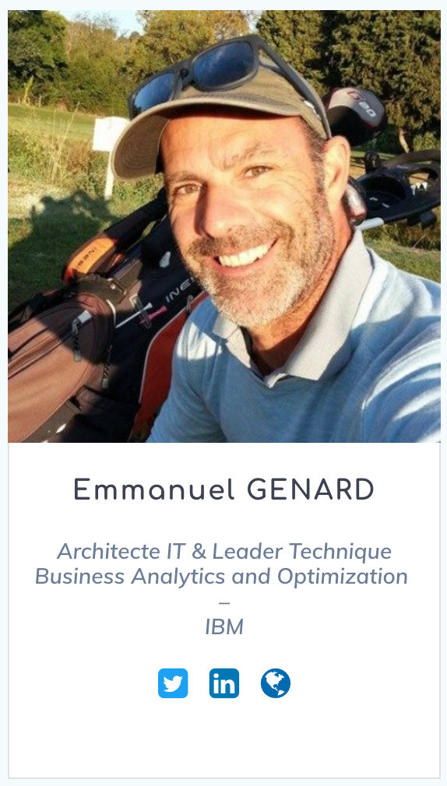


Introduction
I am Emmanuel Génard
You can find me at genard@fr.ibm.com
@manuGenard
http://fr.linkedin.com/in/egenard
Notes:
Qui suis-je?
Objectif des 45 prochaines minutes est:
Montrer que certaines formes d’Intelligence Artificielle peuvent être créer et surtout intégrer dans vos applications pour favoriser la transformation digitale.
→ Machine Learning, Deep Learning, Réseau Neuronaux, Apprentissage supervisé, Apprentissage non-supervisé,
LE deuxième objectif c’est de vous montrer qu’il existe des technologies et des outils qui permettent de démarrer maintenant peut importe (ou presque) votre profil. J’entends par là qu’il ne faut pas obligatoirement avoir un PhD en Mathématiques appliquées, en statistiques ou autre pour y parvenir.

Slide 5
Syllabus
Professor | Yann Gouedo, Emmanuel Génard
What will you learn? | Understand the value of Data & Analytics in the following areas: Digital Marketing, Risk and Fraud management Understand the global data science methodology Use of the IBM Data Science technologies though hands on lab
Software | IBM SPSS Statistics, IBM SPSS Modeler, IBM Watson Studio

Slide 6
Agenda
Lesson
Hands on Lab
Evaluation
Times | Subjects
Lesson 1 (3h)
30’ | Introduction, Agenda, Pre-Requisites & Objectives Evaluation process
30’ | Descriptive Analytics with SPSS Statistics Illustration
30’ | Data Preparation with SPSS Statistics
30’ | Data Vizualisation with SPSS Statistics
45’ | Clustering with SPSS Statistics
15’ | Quizz
Lesson 2 (3h)
30’ | IBM Data Management & Vizualisation with Watson Studio Illustration
45’ | Data Refinery with Watson Studio
45’ | Data Vizualisation with Watson Studio
45’ | Assembing a Dashboard with Watson Studio
15’ | Quizz

Slide 7
Agenda
Lesson
Hands on Lab
Evaluation
Times | Subjects
Lesson 3 (3h)
30’ | Big Data & Analytics (Data Science), a Digital Transformation enabler
45’ | Predictive Analytics with IBM SPSS Modeler Illustration
15’ | IBM SPSS Modeler 101
30’ | Customer Analytics: Predictive Customer Intelligence, Churn Management, Next Best Action
15’ | Customer Analytics: Big Data & Analytics Questions
30’ | Churn Management (Classification Modelling)
15’ | Quizz
Lesson 4 (3h)
30’ | Product affinity (Association Modelling)
30’ | Profiling (Segmentation and Classification Modelling)
30’ | Risk and Fraud Management
15’ | Risk and Fraud Management: Big Data & Analytics Questions
30’ | Suspicious cases (Anomaly Detection Modelling)
15’ | Quizz
30’ | Group Work (Kick Off)

Slide 8
Agenda
Lesson
Hands on Lab
Evaluation
Times | Subjects
Lesson 5 (3h)
30’ | IBM Data Science with IBM Watson Studio
30’ | Modeler Flow (Classification Modelling)
30’ | Auto AI
30’ | Deep Learning (Neural Network)
15’ | Quizz
45’ | Group Work (Mentoring)
Lesson 6 (3h)
30’ | Prescriptive Analytics with IBM Decision Optimization Illustration
45’ | Solving a Planning and Scheduling problem
45’ | The Diet Problem
15’ | Quizz
45’ | Group Work (Mentoring)

Slide 9
Thank You
Yann Gouedo
Data Scientist Leader – Machine Learning / Artificial Intelligence
Marketing / Risk / Fraud / Maintenance
IBM Certified Senior Data Scientist & IBM Certified Senior Architect

